Slide 1

Naptime
Notes:
Trevor: (~1:00)
Intro / Short Story

Slide 2
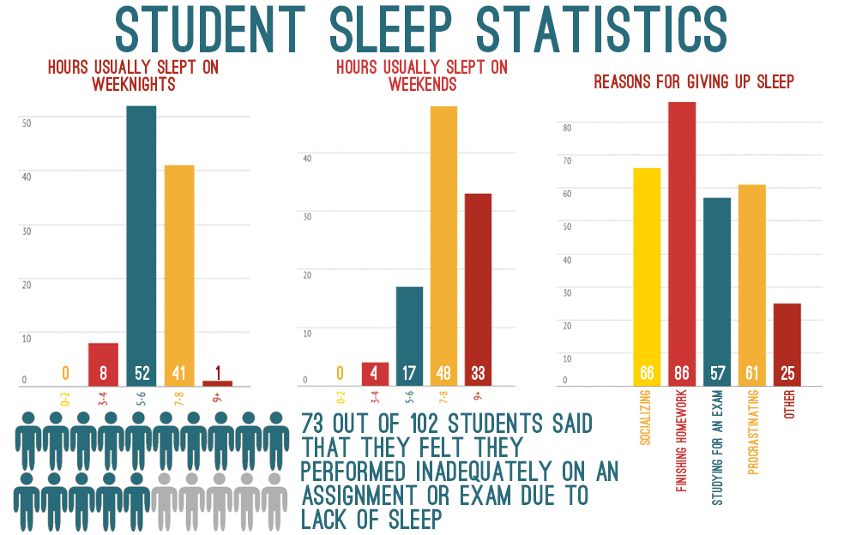
Sleep and College Students
Directly affect mental and physical health
Lower academic performance and reduced mental functionality^{[2]}
78% students nap once or twice a week
Notes:
Trevor: (~0:30)
Clearly college students and sleep have an interesting relationship.
Sleep in students is directly correlated with academic performance. It is also directly affects our mental and physical health.
In one study, 78% of students reported taking a nap once or twice a week (and if you are me it is closer to 5 or 6)
73% of students reported having occasional sleeping problems (less than 3 days a week)^{[1]}
[1] Buboltz, Walter & Brown, Franklin & Soper, Barlow. (2001). Sleep Habits and Patterns of College Students: A Preliminary Study. Journal of American college health : J of ACH. 50. 131-5.
[2] Curcio, G., Ferrara, M. and De Gennaro, L.Sleep loss, learning capacity and academic performance. Sleep Med. Rev., 2006, 10: 323–337.

Slide 3
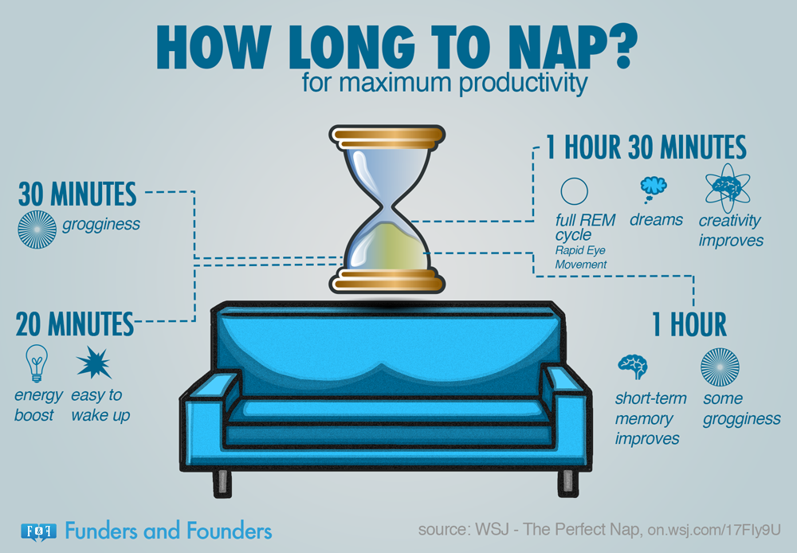
The Science of Napping
Increased alertness and accuracy on tasks^{[1]}
Improves mood, fatigue, and sleepiness (subjective results)^{[1]}
Consuming caffeine before napping showed decreases in sleep inertia^{[2]}
Notes:
Michaela (~0:30)
[1] MILNER, C. E. and COTE, K. A. (2009), Benefits of napping in healthy adults: impact of nap length, time of day, age, and experience with napping. Journal of Sleep Research, 18: 272-281. doi:10.1111/j.1365-2869.2008.00718.x
[2] Milner, C. E., Fogel, S. M. and Cote, K. A.Habitual napping moderates motor performance improvements following a short daytime nap. Biol. Psychol., 2006, 73: 141–156.

Slide 4

Why Coffee Naps?
Adenosine makes you tired
Adenosine clears receptors during sleep
Less competition for caffeine to adhere
Voila! A nap that is not worth sleeping on!
Notes:
Michaela ~(0:30)

Slide 5
Value Proposition
At Naptime, we strive to provide a relaxing environment so re-energizing your day is easy and convenient. Unlike normal coffee shops, Naptime focuses on emphasizing the importance of mental health and proper sleep to leave you feeling revitalized and wanting to finish your day strong.
Notes:
Michaela (~0:30)

Slide 6
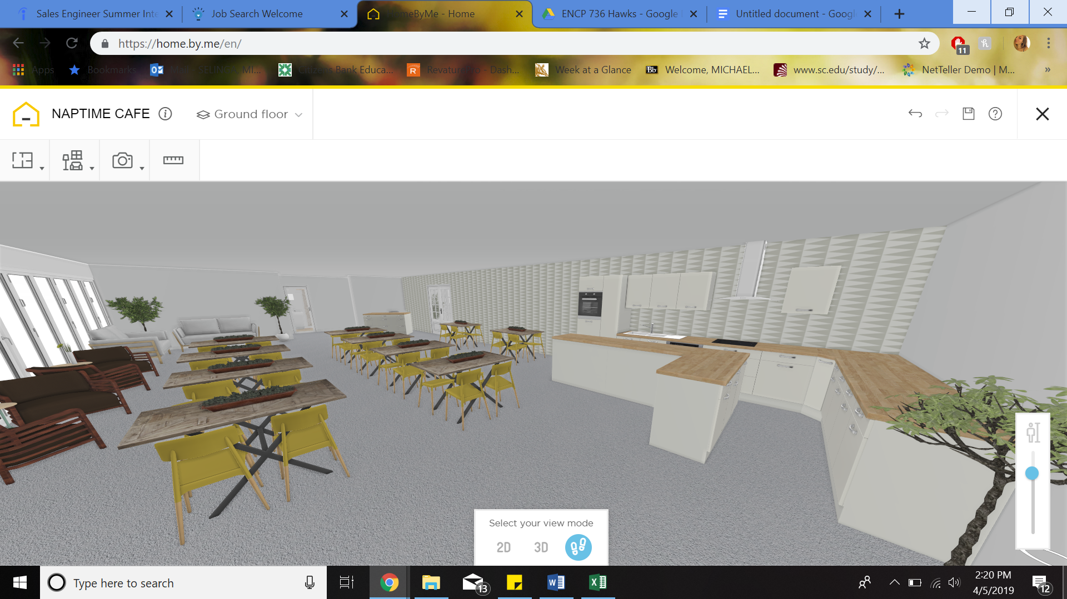
The Concept
Notes:
(~0:15)

Slide 7
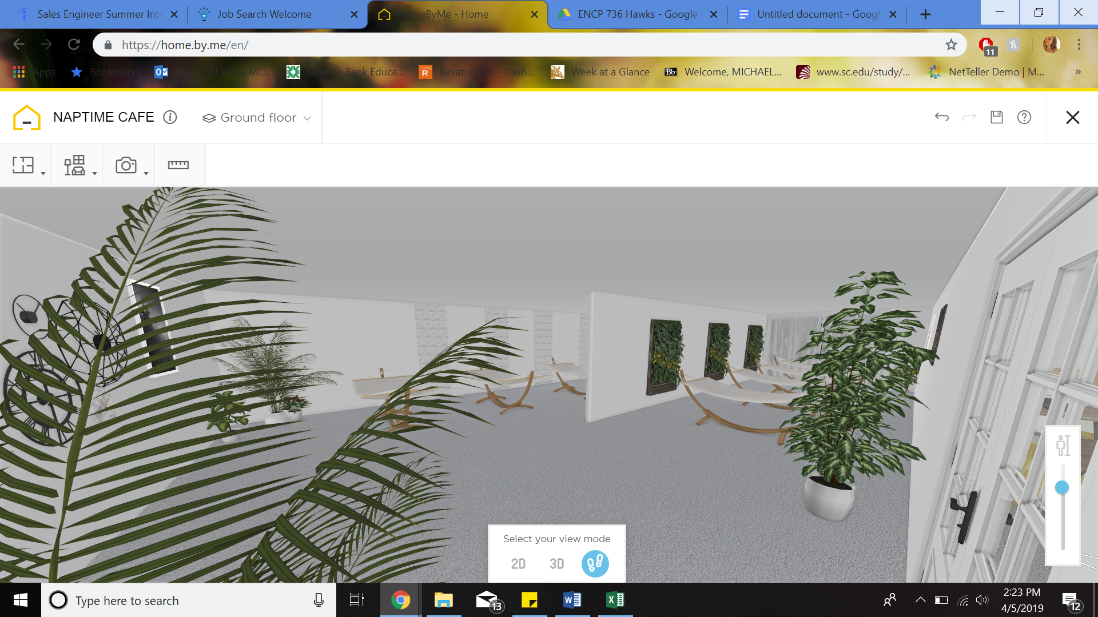
The Concept (cont.)
Notes:
~(0:15)

Slide 8
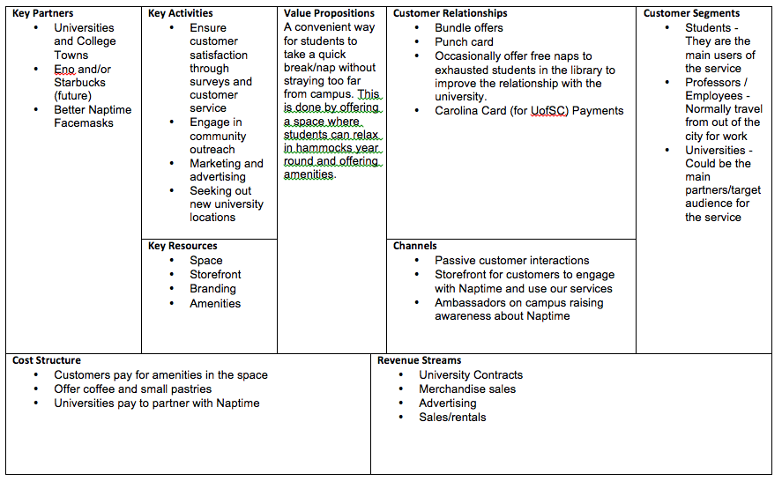
Business Model
Notes:
Ryan (20-30 sec)
Looking at these sections of our business model canvas show how we intend to deliver our value proposition of offering an easy and convenient location close to campus for not only students but also university professors and other employees. Our revenue streams will consist of university contracts, merchandise sales, rentals fees, and advertising for local businesses.

Slide 9


Competitive Landscape
No direct competitors in the market
Russell House
Thomas Cooper Library
Coffee shops/cafes in the area
Starbucks, Einstein’s Bagels
Cool Beans and Immaculate Consumption
Notes:
Ryan (30 s)
There are no direct competitors within the Columbia market. Russell House offers relaxing activities such as an oxygen bar but this is only around final exams, and Thomas cooper library offers a place for students to study but its often packed and its impossible to nap at those desks. Surrounding campus are several coffee shops such as Cool beans, drip, and Immaculate consumption and Starbucks and Einsteins have locations on campus but once again people cant sleep here since theyre often busy and loud environments with people coming in and out and ordering drinks

Slide 10
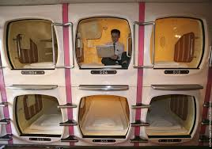
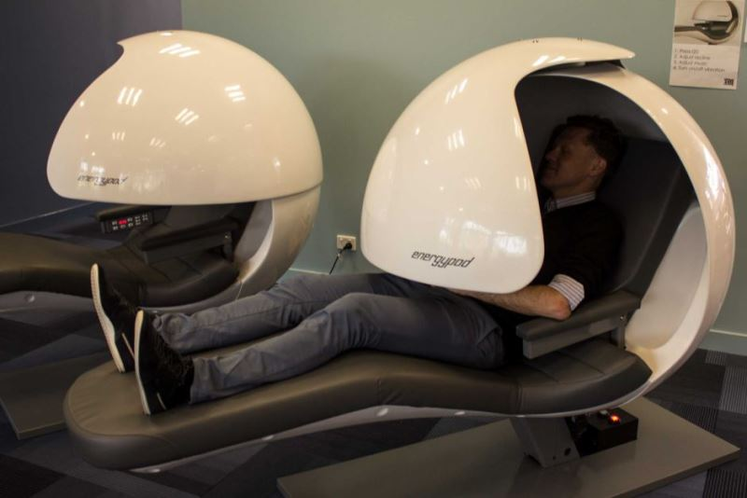
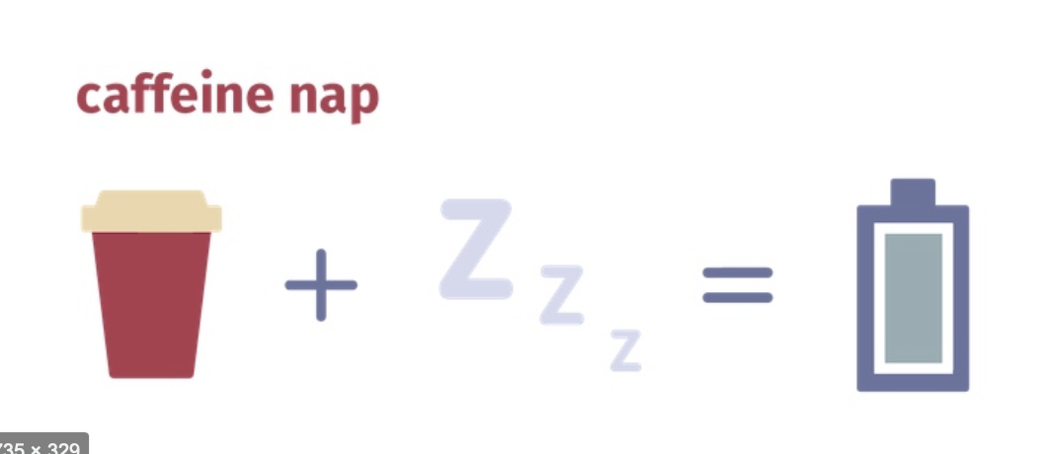
Competitive Landscape
Napping “pods” exist in various locations across the world.
Airports, hotels, large corporations
We are combining these two services in a new way.
Notes:
There has been a rise in interest for so called nap pods, with them appearing in companies like Google, airports, and even nap pod hotels in japan, but we are combining the nap pod service with a coffee shop experience to help people relax and recharge in an entirely new way

Slide 11
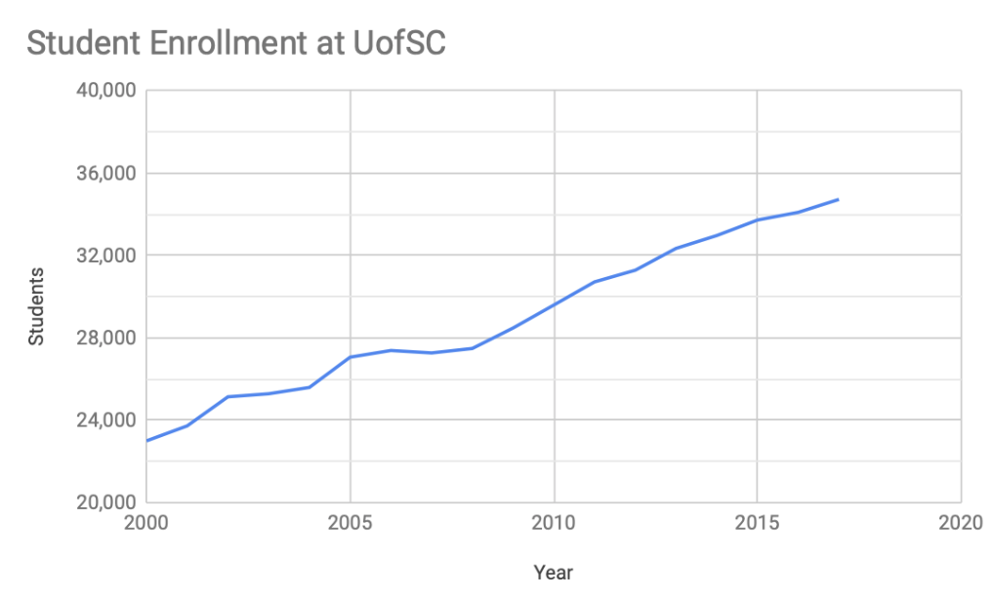
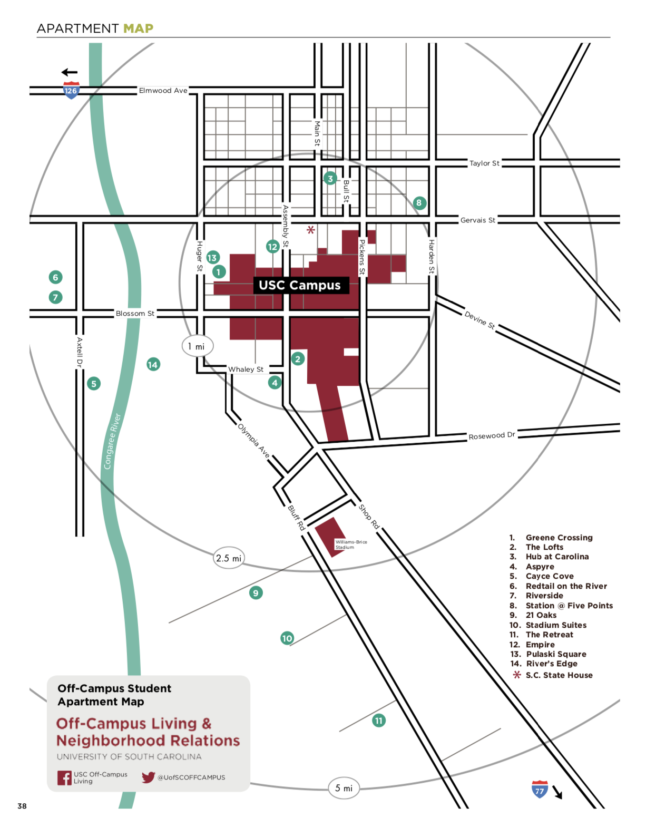
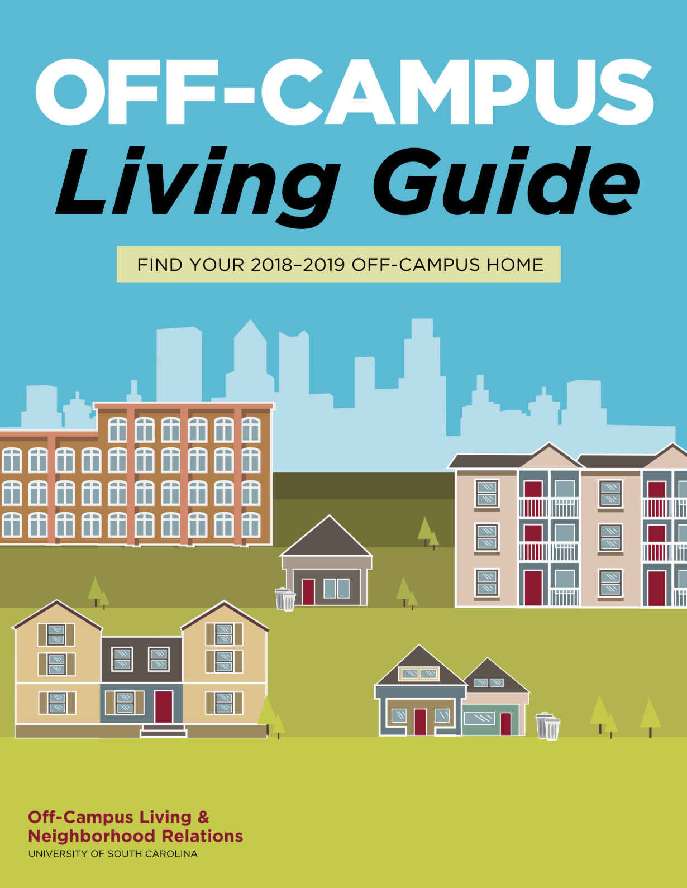
Why now?
College enrollment is increasing at UofSC.
More students will live off campus as enrolment increases.
Notes:
Trevor: (~0:30)
70% of students live off campus at UofSC ^{[1]}
Freshmen are required to live on campus
Limited number of upperclassmen live on campus
34,094 students enrolled at UofSC as of 2017 ^{[2]}
~23,800 students off campus
As it grows, freshmen are being placed placed in apartments off campus so they are forced to drive or take a shuttle
Target colleges where a majority of the students live off campus.
[1] https://www.sc.edu/experience/living_here/ [2] http://ipr.sc.edu/enrollment/prel2017/fall/prelim/pr101917.pdf

Slide 12
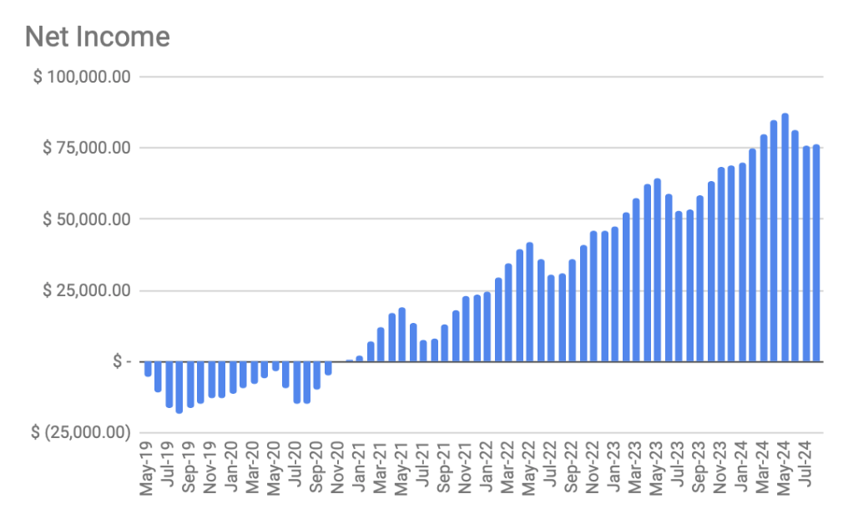
Financials
Projections based on $40,000 investment
Additional $50,000 in loans assumed
This includes seasonality of school operations
Does not account for UofSC enrollment growth
Notes:
Trevor (~1:00)
Assumptions:
The financials were based on several assumptions. Firstly on a $40,000 investment and a $50,000 loan.
We assumed an average value of 225 customers per day for the cafe and 25 naps sold per day. The average Starbucks sees between 400 and 750 customers per day and there is no comparison for naps sold. However, we took our maximum number of naps possible ~(80) and projected ~30% of that.
Our space will be 2,000sq/ft at $20/sqft/year rent $3500 / month
Since we are primarily on college campuses, we chose to close the shop every summer (Mid may - July) since there will be significantly less customers.

Slide 13
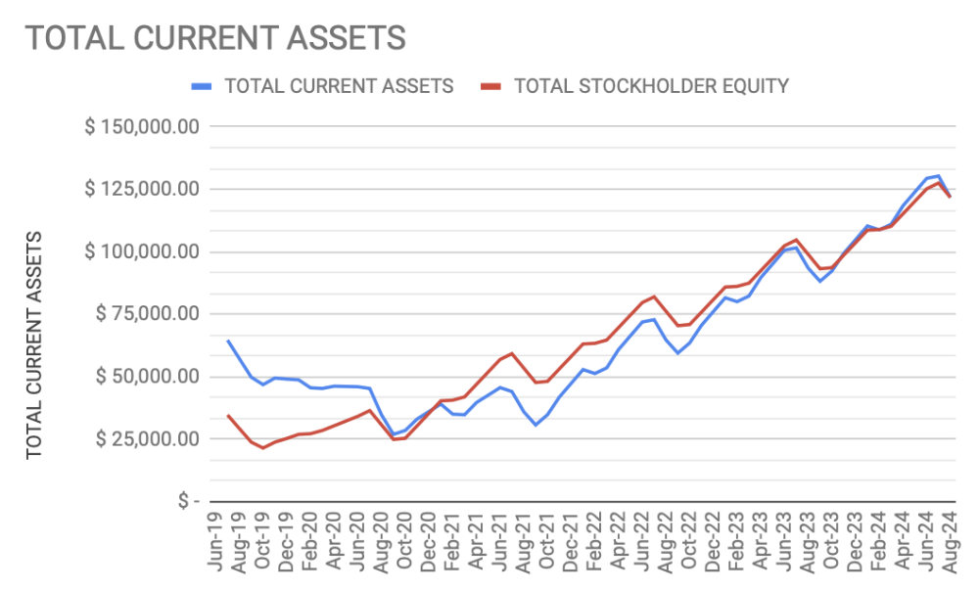
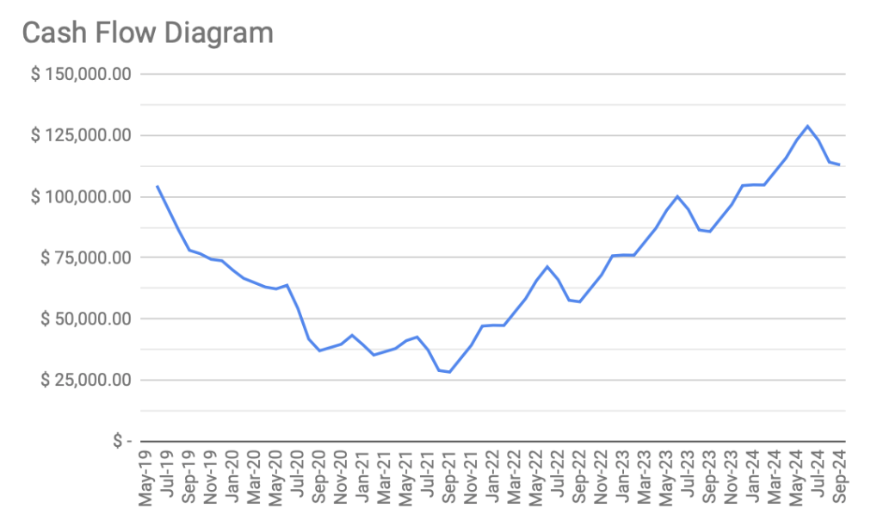
Financials
~$25,000 Cash buffer.
Equity value starts increasing in 2 years
Potential for greater returns if more locations are opened within the first 4 years.
Notes:
Trevor: (~0:30)
Buffer in case of any unplanned expenses or problems that arise.
Positive Cash flow starting in 2 years.

Slide 14

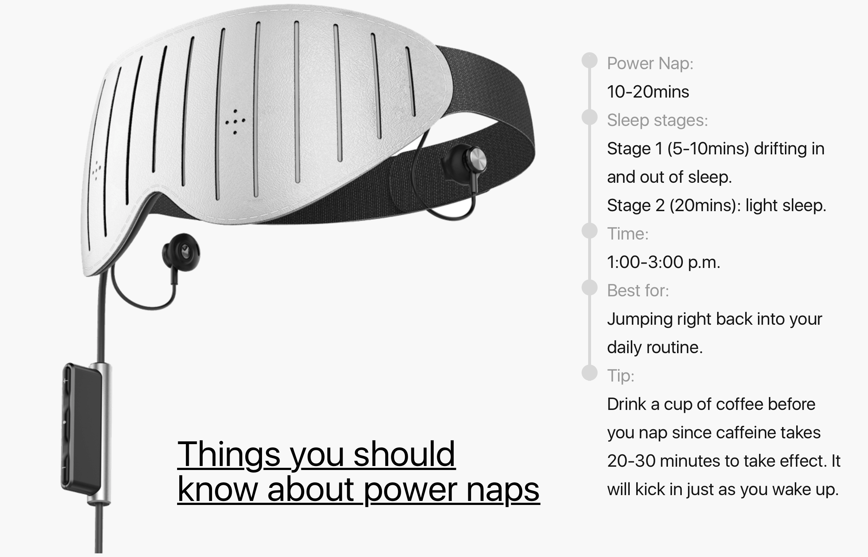

Potential Partnerships
Eagles Nest Outfitters, Inc.
Naptime by Entertech
Starbucks Coffee Company
Notes:
Trevor: (~0:30)
Starbucks: Coffee Supplier
Eno: Hammock Supplier
Naptime by Entertech, -> Offers high tech sleeping masks to allow for better more restful sleep.

Slide 15
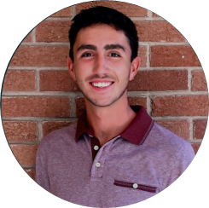
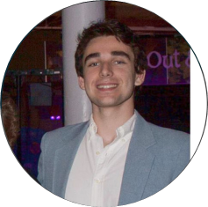
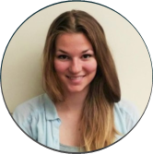
Team
Trevor Schachner
President and originator of the Naptime concept
Ryan Uliana
Chief Operations Officer
Michaela Selinga
Design Engineer
Notes:
Michaela (~0:30)
Financial Manager
Cafe Operators (5)
Nap Room Attendants (2)
Trevor: His interest in napping became largely apparent when entering into the University of South Carolina in 2015. Paired with his background in Mechanical Engineering, Trevor designed a functional and practical way to re energize on the go.
Michaela: With 5 years of customer service, Michaela designed the layout of the restaurant to be the most pleasing and relaxing environment for the customer. Her background in Biomedical Engineering also ensures that the layout and experience promotes mental positivity and comfort with the introduction of technology into the napping experience.
Ryan: With his background in Biomedical Engineering, Ryan pays large attention to detail and expresses many plans through the use of spreadsheets and graphical analysis. Ryan is to oversee restaurant operations and ensure project completion is following through

Slide 16

Milestones
Develop a profitable business model
Gain funding
Gather necessary resources
Rental space, coffee supplies, ENO hammocks
Hire and train a team
Gain first repeat customer
Notes:
Ryan: 30 second

Slide 17


Where We Are Going…
Determine feasibility and sustainability
Open second location
Refine business model
Expand to new campuses
Notes:
Trevor : (~0:45)
First location at UofSC to determine feasibility and refine business model.
What draws the most customers? (location, pricing, etc.)
Is our business sustainable? (seasonality, number of users, university partnership)
Open second location after the first reaches profitability.
Location influenced by information gathered
Continue refining our business model and expanding to new universities.
Build stronger partnerships with universities
Develop lasting relationships in each college community

Slide 18
Refresh
Revitalize
& Replenish
It’s Naptime

